Slide 1
Ridership Stats and Opportunities with New York MTA Data
WomenTechWomenYes International
BenAri Consulting

Slide 2

Introduction
WTWY International Awareness
Maximize Gala Participation
Success Go Forward Strategy
How Will We Do This?
Data Driven Insights
Optimization of Strategy
Successful Gala

Slide 3
Methodology
Maximize Awareness and Participation
Analyzing MTA Ridership
Highest Median Ridership
Why Median?
Time Series and Stability
Weather Correlations
Notes:
Data, Models, Metrics, Tools

Slide 4
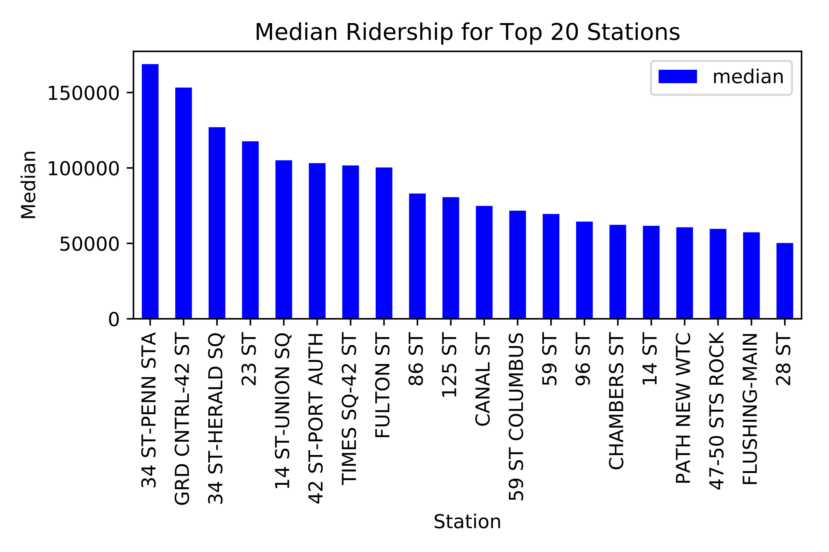
Methodology
MTA Data [Link]
Median Ridership Top 20 Stations
Median Ridership Over Time
IQR of Ridership Over Time
Notes:
Data, Models, Metrics, Tools

Slide 5
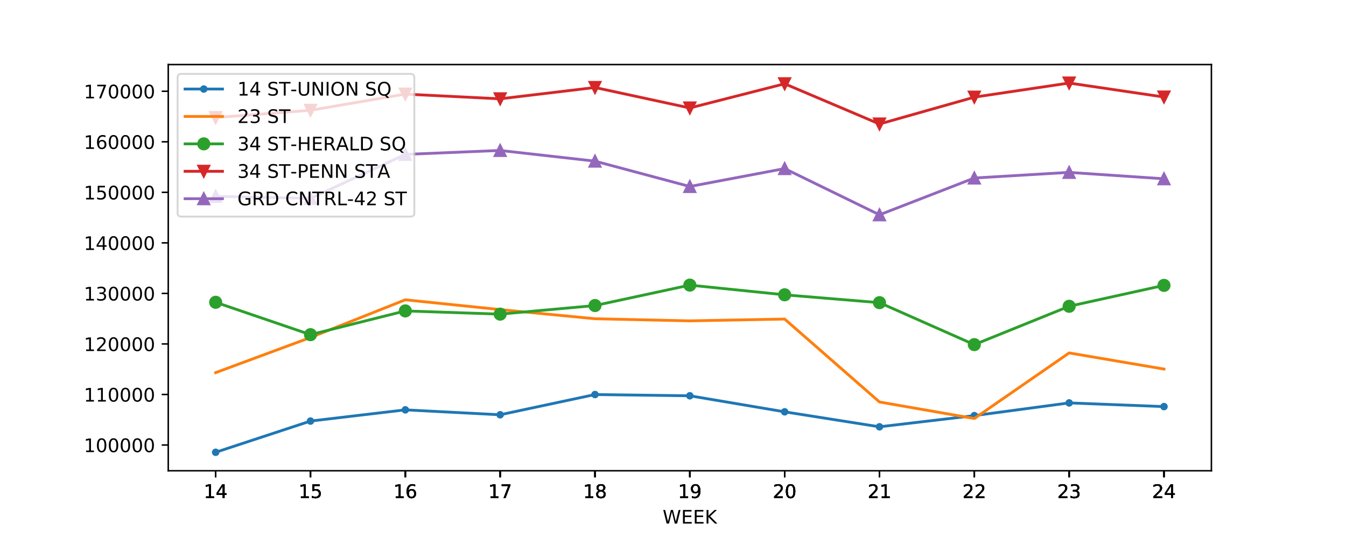
Results
Median by Week of Top 5 Stations
Medians by Week
Notes:
ROC Curve, Accuracy, $ Saved, Adj R^2, MSE

Slide 6
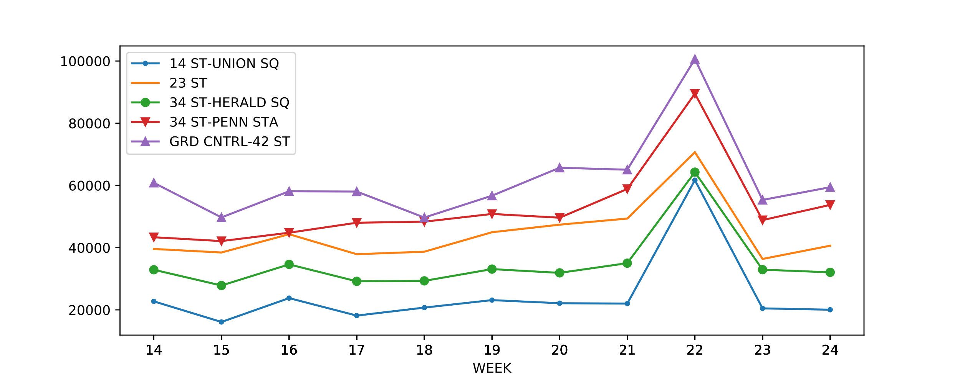
Results
IQR by Week of Top 5 Stations
IQR by Week
Notes:
ROC Curve, Accuracy, $ Saved, Adj R^2, MSE

Slide 7
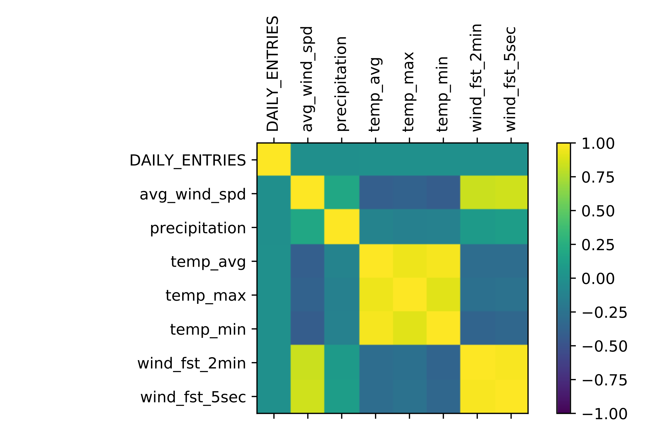
Results
Weather Indicators
No Correlations Overall
Notes:
ROC Curve, Accuracy, $ Saved, Adj R^2, MSE

Slide 8
Conclusions
Staff to these 5 stations
Notes:
Recommendations, Interesting Insights

Slide 9
Future Work
Weather Correlations by Stations
Multiple Years Runs for same time frame
Street Team Travel Distance Optimization
Notes:
Recommendations, Interesting Insights

